Slide 1



MONOPOLY GAmE
MEMBERS:
Yoanna Mareva
Geno Genov
Svetoslav Enchev
Martin Antonov
Svetlozar todorov
Martin Tonkov

Slide 2
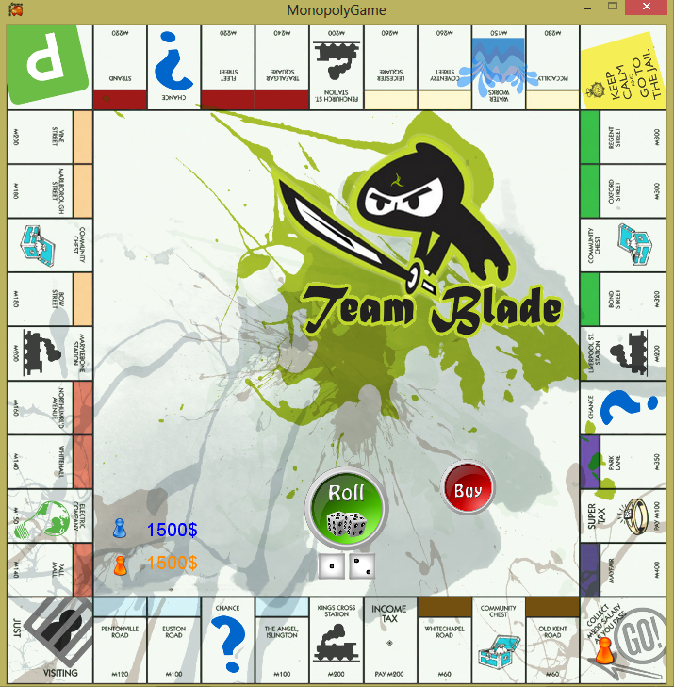
Demo

Slide 3
Technical implementation
Rules
Gameplay
Technicalities
Known Issues
Further development

Slide 4
Let’s play!

